Slide 1
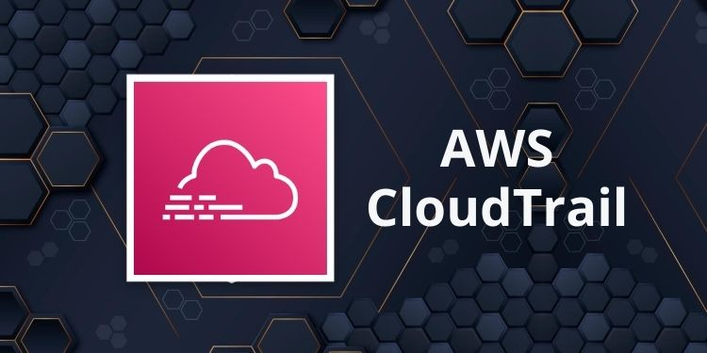
Presented by Pavan Chaitanya

Slide 2
AWS CloudTrail
Agenda:
What is AWS CloudTrail?
Why AWS CloudTrail?
AWS CloudTrail Features
AWS CloudTrail Pricing
CloudTrail Event History

Slide 3
What is AWS CloudTrail?
AWS CloudTrail is an auditing, compliance monitoring, and governance tool from Amazon Web Services (AWS).
It’s classed as a “Management and Governance” tool in the AWS console.

Slide 4
With CloudTrail, AWS account owners can ensure every API call made to every resource in their AWS account is recorded and written to a logs.
Like:-
when a resource is accessed from the AWS console
when someone runs an AWS CLI command
when a REST API call is made to an AWS resource

Slide 5
These actions can be coming from:
Human users (e.g. when someone spins-up an EC2 instance from the console)
Applications (e.g. when a bash script calls an AWS CLI command)
another AWS service (e.g. when a Lambda function writes to an S3 bucket).

Slide 6
CloudTrail saves the API events in a secured, immutable format which can be used for later analysis.
AWS CloudTrail is now enabled for all users by default.

Slide 7
Why AWS CloudTrail?
Someone working in DevOps can view,
search for, or analyze CloudTrail logs to find:
any particular action that happened in the account.
the time the action happened.
the user or process that initiated the action.

Slide 8
the resources that were affected by the action.
Having this kind of visibility can be useful for post security breach reviews,
proactive AWS monitorig for account vulnerabilities (or)
ensuring adherence to compliance standards. What’s more, events from custom trail events can be used to trigger specific actions.

Slide 9
AWS CloudTrail Features
It has a number of features expect from a monitoring and governance tool.
Features :
AWS CloudTrail is “Always On,” enabling you to view data from the most recent 90 days.
Event History to allow you to see all changes made.
It is a Multi-region configuration.
Log file integrity validation and encryption.
And we have Data events, management events, and CloudTrail Insights.

Slide 10
Amazon CloudTrail Pricing
Amazon CloudTrail pricing is free of charge.
in a single trail you can even download, filter, and view data from the most recent 90 days for all management events at no cost.
Keep in mind Amazon S3 charges will apply based on your usage.

Slide 11
But in AWS CloudTrail Insights are charged per the number of events in each region.
Pricing is as follows:
Management Events: $2.00 per 100,000 events
Data Events: $0.10 per 100,000 events
CloudTrail Insights: $0.35 per 100,000 write management events

Slide 12
CloudTrail Event History
It is default event when an aws account is created.
It keeps the information of last 90days events history only.

Slide 13
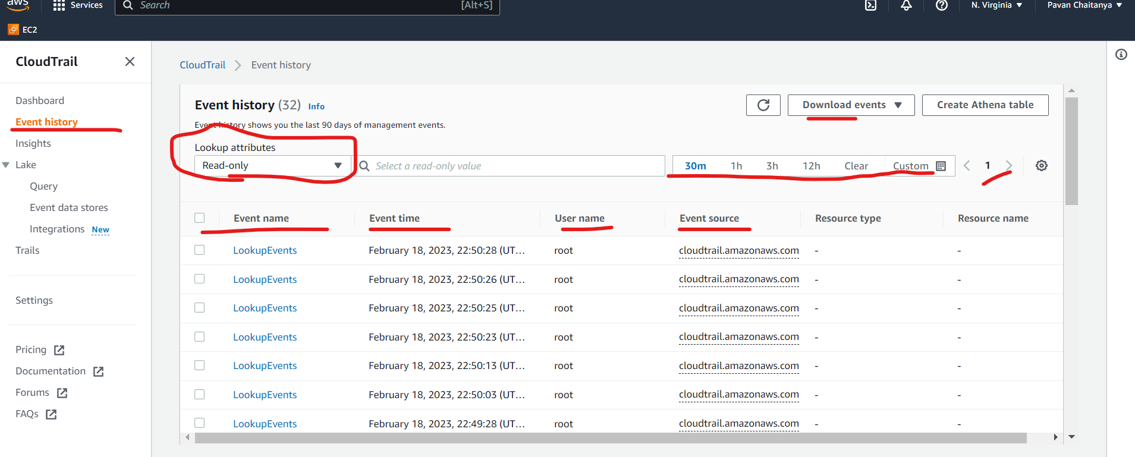
If u want to check the event history report

Slide 14
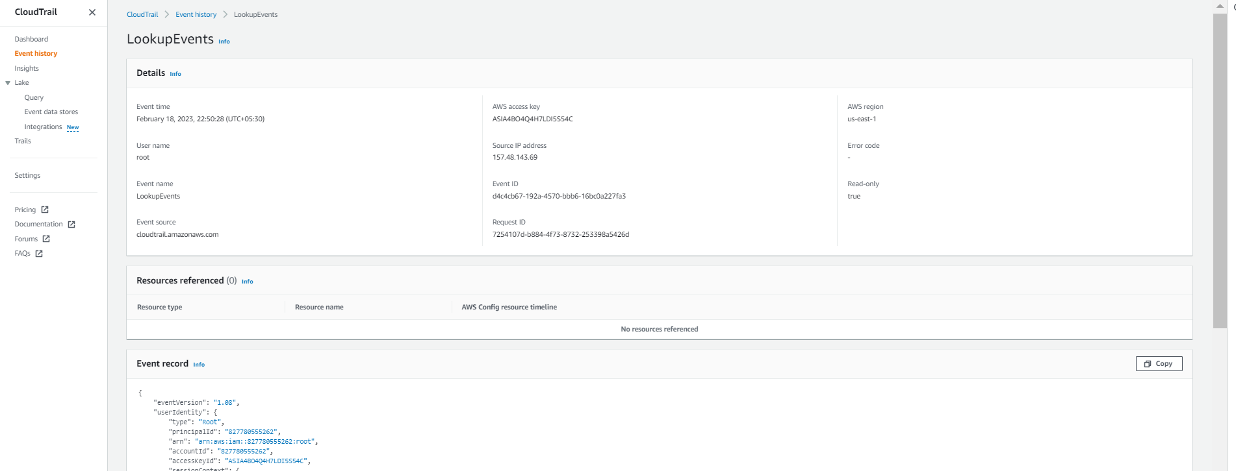
If you want to check the particular event report it will show like this in json

Slide 15
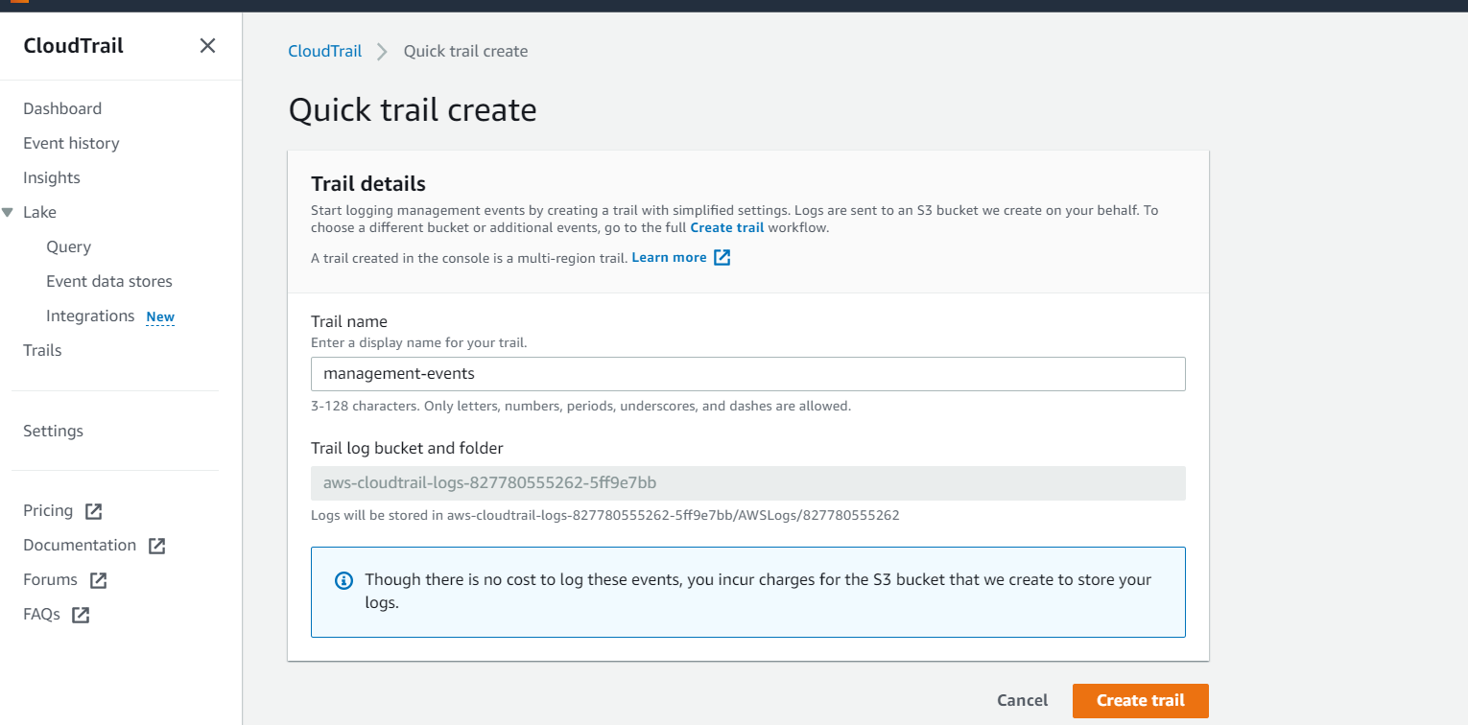
Creating a trail

Slide 16
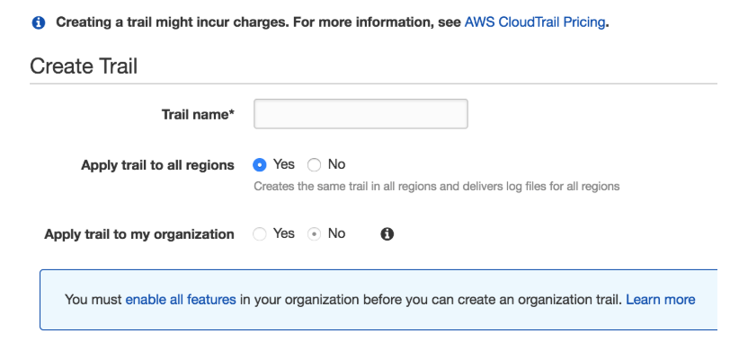

Slide 17
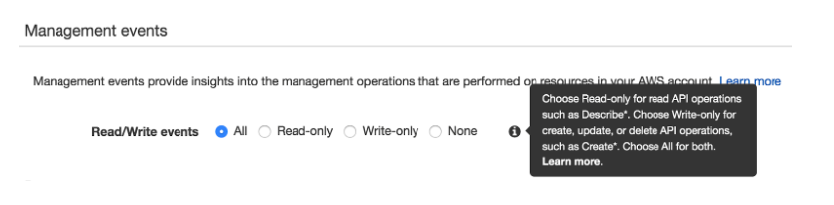
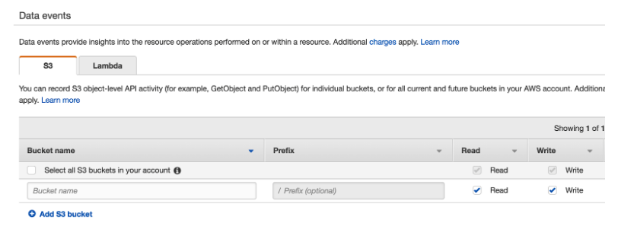

Slide 18
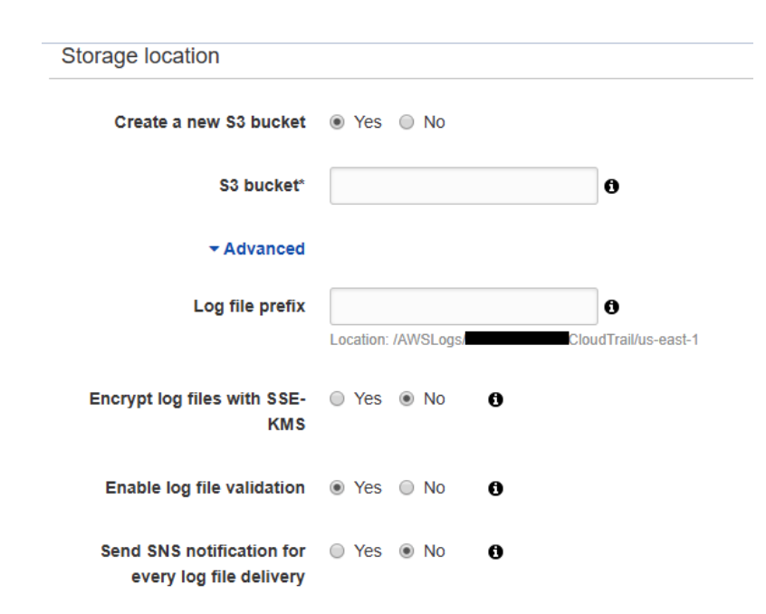

Slide 19
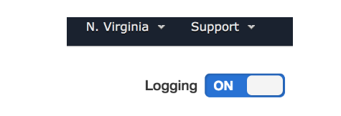
We can enable or disable an existing trail by toggling the button at the top right corner of the trail’s property screen:

Slide 20
Thankyou very much

